Slide 1
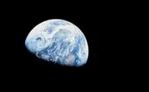
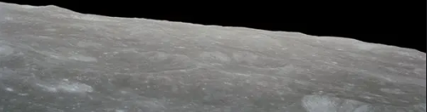
Stranded on the Moon!
Will you survive?

Slide 2
The movie the Martian explores a similar scenario…..
The Martian Movie Trailer

Slide 3
Scenario
You are a member of a space crew originally scheduled to rendezvous with a mother ship on the bright (lighted) surface of the moon.
However, due to mechanical difficulties, your ship crashed at a spot some 200 miles from the rendezvous point. You now need to travel to the rendezvous point.
During the crash landing, most of the equipment aboard was damaged and you MUST choose the most important items for the 200-mile trip.

Slide 4
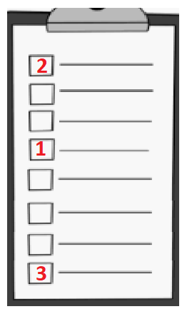
Instructions
You have a list of 15 items.
Your task is to rank order them in terms of their importance to help you reach the rendezvous point.
Place the number 1 by the most important item, the number 2 by the second most important, and so on through number 15 for the least important.
Every item must have a number on it
You cannot have duplicate numbers (can’t make two items 15 for example)

Slide 5
Instructions Continued
There are two phases to this activity
Phase 1 – Individual Ranking – it is important to work by yourself – no sharing of ideas, this will come later
Phase 2 – Group Ranking – it is important to work in a group – share ideas, value those opinions of others, critically think about ideas.

Slide 6
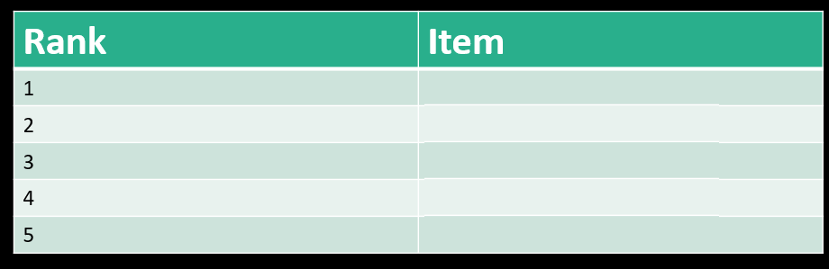
Expert Rankings
Top 5
Oxygen
Water
Stellar Map
Food
Receiver-Transmitter

Slide 7
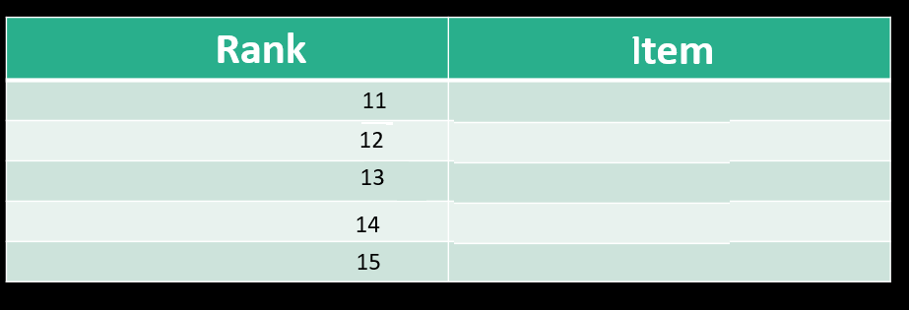
Expert Rankings
Bottom 5
Pistols
Dehydrated Milk
Portable Heating Unit
Compass
Matches

Slide 8
Expert Rankings
Middle 5
Rank | Item
6
7
8
9
10
Rope
First Aid Kit
Parachute
Raft
Flares

Slide 9
Results
0 - 25 excellent
26 - 32 good
33 - 45 average
46 - 55 fair
56 - 70 poor -- suggests use of Earth-bound logic
71 - 112 very poor – you’re one of the casualties of the space program!

Slide 10
Debrief
1. What was the benefit of working alone individually?
2. What was the benefit of working together as a group after your individual work?
3. What can this tell us about how we should work in groups?

